Slide 1
Polynomial Functions
Precalculus
Chapter 2

Slide 2
This Slideshow was developed to accompany the textbook
  Precalculus
  By Richard Wright
  https://www.andrews.edu/~rwright/Precalculus-RLW/Text/TOC.html
Some examples and diagrams are taken from the textbook.
Slides created by
Richard Wright, Andrews Academy
rwright@andrews.edu

Slide 3
2-01 Complex Numbers
In this section, you will:
Express square roots of negative numbers as multiples of i.
Plot complex numbers on the complex plane.
Add and subtract complex numbers.
Multiply and divide complex numbers.

Slide 4


2-01 Complex Numbers
Imaginary Unit
  $i=\sqrt{−1}$
  $i^{2}=−1$
Complex Number
  $a+bi$
  a is real part
  bi is imaginary part

Slide 5

2-01 Complex Numbers
Graphing complex points
Complex plane
  Horizontal axis = Real
  Vertical axis=Imaginary
Graph
  $3+2i$
  $−2−4i$

Slide 6


2-01 Complex Numbers
Operations
  Add/Subtract
  Combine like terms
$\left(2+3i\right)+(6−2i)$
Multiplication
  $i^{2}$ becomes -1
$(2+3i)(6−7i)$
Notes:
$$8−4i$$
$$12−14i+18i−21i^{2}$$
$$12−14i+18i+21$$
$$33+4i$$

Slide 7


2-01 Complex Numbers
$(3+i)(3−i)$
Complex Conjugates
$a+bi$ and $a−bi$
When complex conjugates are multiplied, the product is real
Notes:
10

Slide 8

2-01 Complex Numbers
Division
  Multiply by conjugate of denominator
$\frac{2−3i}{4+6i}$
Notes:
$$\frac{\left(2−3i\right)}{\left(4+6i\right)}\frac{\left(4−6i\right)}{\left(4−6i\right)}$$
$$\frac{8−12i−12i+18i^{2}}{16−24i+24i−36i^{2}}$$
$$\frac{8−12i−12i+18(−1)}{16−24i+24i−36(−1)}$$
$$\frac{−10−24i}{52}$$
$$−\frac{5}{26}−\frac{6}{13}i$$

Slide 9

2-01 Complex Numbers
${\left(5−i\right)}^{2}$
Notes:
$$\left(5−i\right)\left(5−i\right)$$
$$25−5i−5i+i^{2}$$
$$24−10i$$

Slide 10


2-01 Complex Numbers
$\sqrt{−14}\sqrt{−2}$
$\sqrt{−27}−\sqrt{−12}$
Notes:
$$i\sqrt{14}•i\sqrt{2}$$
$$i^{2}\sqrt{28}$$
$$−1\sqrt{4}\sqrt{7}$$
$$−2\sqrt{7}$$
$$i\sqrt{9}\sqrt{3}−i\sqrt{4}\sqrt{3}$$
$$3i\sqrt{3}−2i\sqrt{3}$$
$$i\sqrt{3}$$

Slide 11
2-02 Quadratic Equations
In this section, you will:
Recognize characteristics of parabolas.
Understand how the graph of a parabola is related to its quadratic function.
Determine a quadratic function’s minimum or maximum value.
Solve problems involving a quadratic function’s minimum or maximum value.

Slide 12
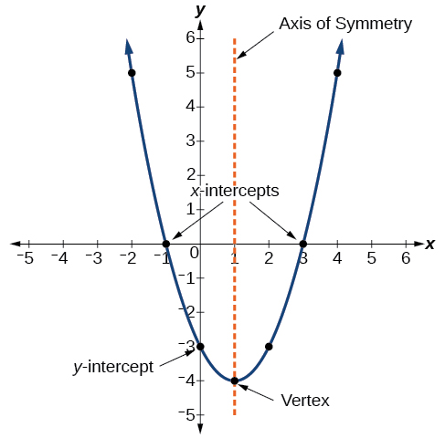

2-02 Quadratic Equations
$f\left(x\right)=ax^{2}+bx+c$
$\left|a\right|>1$ → thinner
$0<\left|a\right|<1$ → wider
$a<0$ → reflected over x-axis “opens down”
$a>0$ → “opens up”

Slide 13


2-02 Quadratic Equations
Standard Form
$f\left(x\right)=a{\left(x−h\right)}^{2}+k$
  Vertex (h, k)
  Axis of symmetry $x=h$
To graph
  Find vertex
  Make table around vertex
  Draw parabola
General Form
$f\left(x\right)=ax^{2}+bx+c$
  Vertex $\left(−\frac{b}{2a}, f\left(−\frac{b}{2a}\right)\right)$
  Axis $x=−\frac{b}{2a}$

Slide 14

2-02 Quadratic Equations
Graph $f\left(x\right)=x^{2}−10x+25$ and identify the vertex and axis of symmetry
Notes:
Vertex: (5, 0)
Axis of symmetry: x = 5

Slide 15

2-02 Quadratic Equations
Write the standard form of the equation of parabola with vertex $(−4, 11)$ and passes through $(−6, 15)$
Notes:
$$y=a{\left(x+4\right)}^{2}+11$$
$$15=a{\left(−6+4\right)}^{2}+11$$
$$4=a4$$
$$a=1$$
$$y={\left(x+4\right)}^{2}+11$$

Slide 16


2-02 Quadratic Equations
Maximum and minimum
Occurs at the vertex
Quadratic formula
$x=\frac{−b±\sqrt{b^{2}−4ac}}{2a}$
Solve $8x^{2}+14x+9=0$
Notes:
$$x=\frac{−14±\sqrt{{14}^{2}−4\left(8\right)\left(9\right)}}{2\left(8\right)}$$
$$x=\frac{−14±\sqrt{−92}}{16}$$
$$x=\frac{−14±2\sqrt{23}i}{16}$$
$$x=−\frac{7}{8}±\frac{\sqrt{23}}{8}i$$

Slide 17
2-03 Polynomial Equations
In this section, you will:
Identify polynomial functions.
Identify the end behavior.
Graph polynomial functions.
Write polynomial functions.

Slide 18

2-03 Polynomial Equations
Polynomial Function
$f\left(x\right)=a_{n}x^{n}+a_{n−1}x^{n−1}+⋯+a_{2}x^{2}+a_{1}x+a_{0}$
$a_{n}$ are coefficients
$a_{n}x^{n}$ are terms
$a_{0}$ is constant term
Degree is highest exponent
Leading coefficient is coefficient of term with highest exponent
Graphs are continuous, smooth, rounded turns

Slide 19

2-03 Polynomial Equations
End Behavior
  Polynomial functions always go towards ∞ or -∞ at either end of the graph
What is the end behavior of $f\left(x\right)=\frac{1}{3}x^{3}+5x$?
 | Leading Coefficient + | Leading Coefficient -
Even Degree
Odd Degree
Notes:
Odd degree and positive leading coefficient
Falls to left and rises to right

Slide 20


2-03 Polynomial Equations
Zeros
If $x=a$ is a zero of $f\left(x\right)$
  $x=a$ is a solution to $f\left(x\right)=0$
  $(a, 0)$ is x-intercept
  $(x−a)$ is a factor of $f(x)$
Let $f(x)$ have degree n
  At most n zeros (can be repeated)
  At most $n−1$ turning points

Slide 21
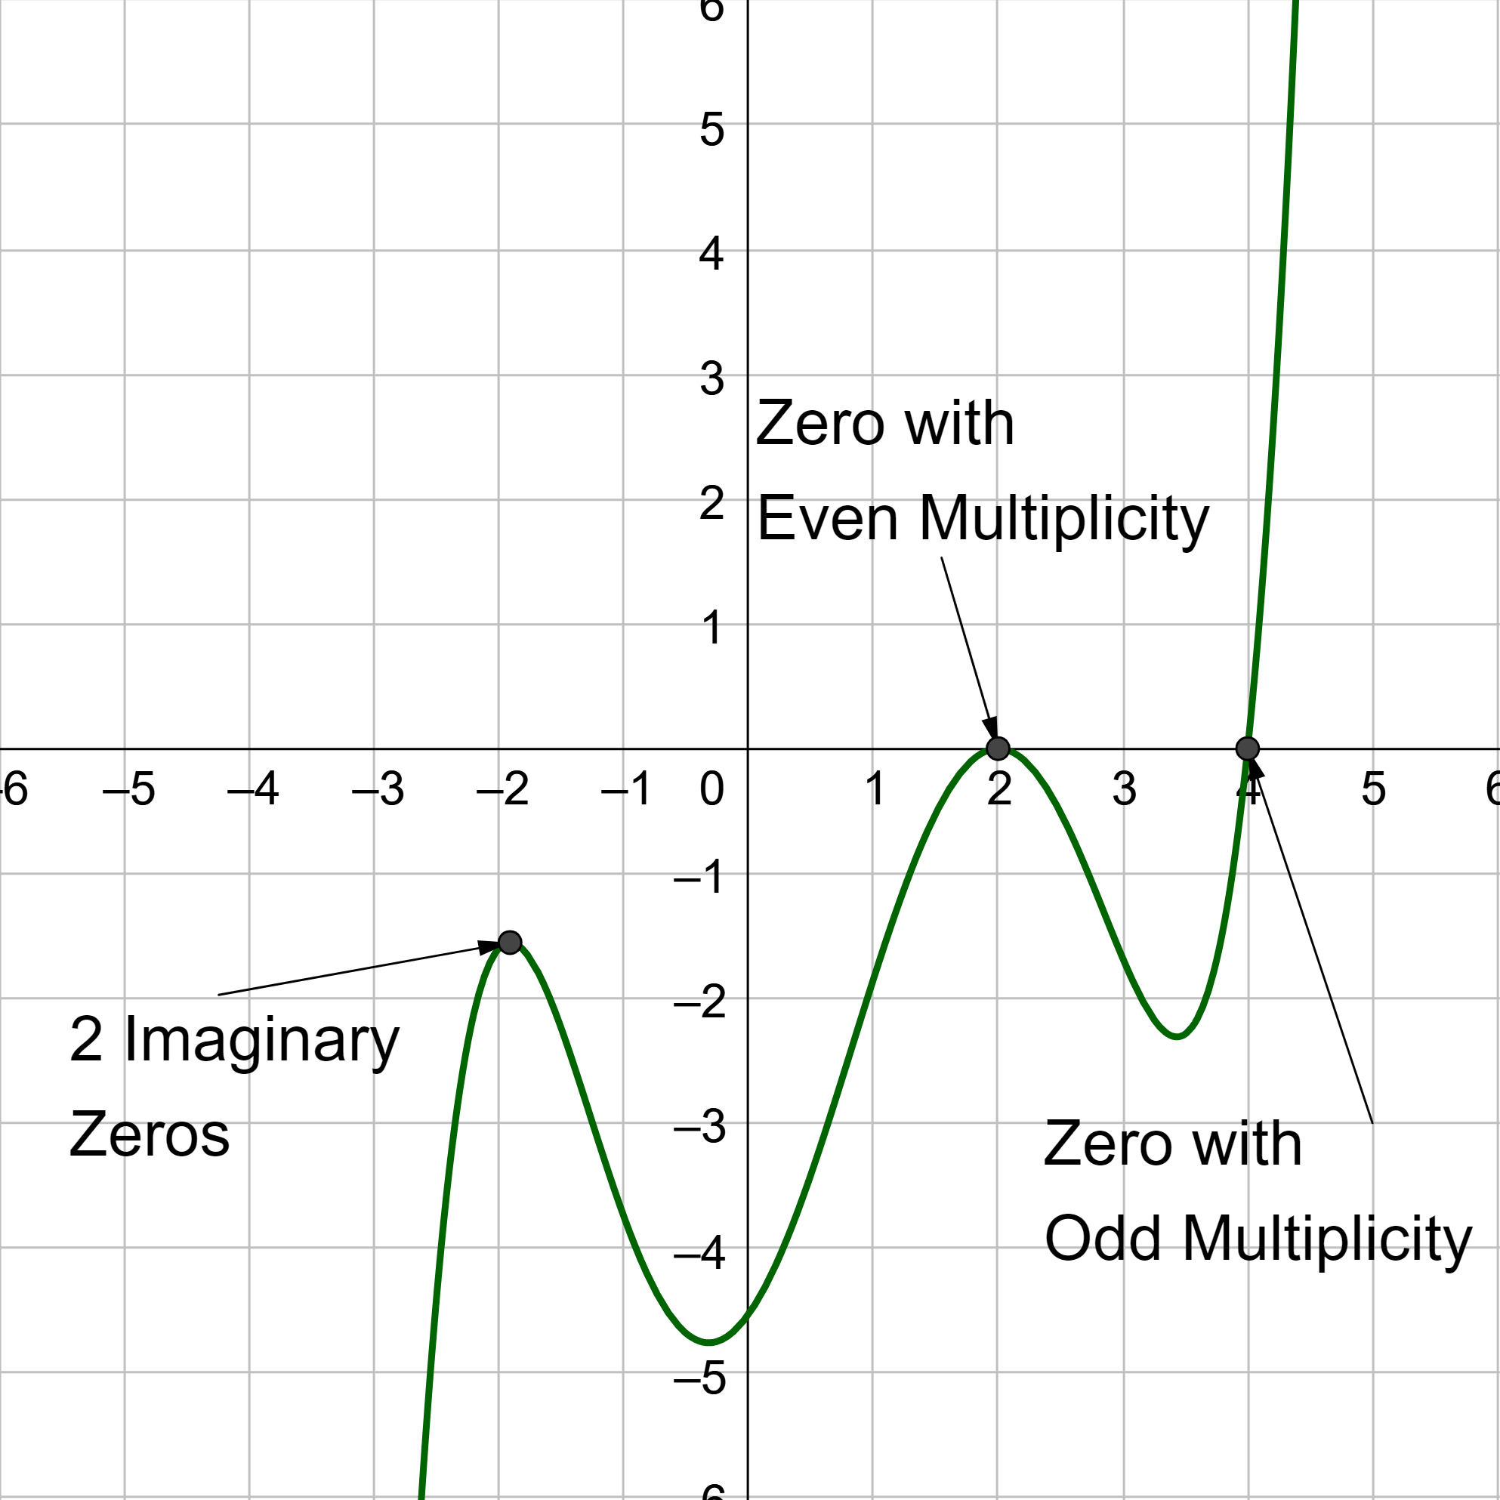
2-03 Polynomial Equations

Slide 22

2-03 Polynomial Equations
For $g\left(t\right)=t^{5}−6t^{3}+9t$
Find all zeros
Find multiplicity of zeros
Graph
Notes:
Factor
$0, \sqrt{3}, −\sqrt{3}$
0: 1; $\sqrt{3}$: 2; $−\sqrt{3}$: 2
Very tall graph

Slide 23

2-03 Polynomial Equations
Find the intercepts of $f\left(x\right)=x(x+2)(x−3)$
Notes:
X-int: 0, -2, 3 (let y=0 and solve for x)
Y-int: 0 (let x=0 and solve for y)

Slide 24
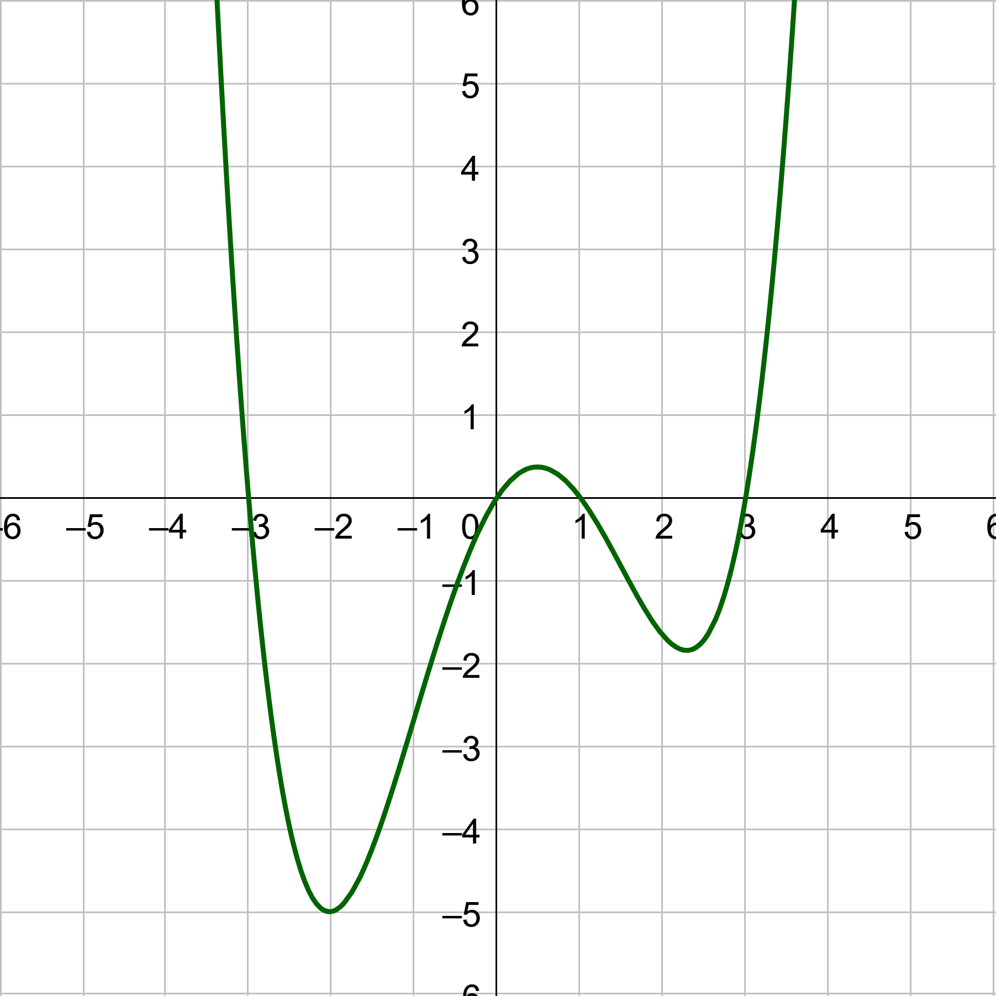
2-03 Polynomial Equations
Determine the least possible degree of the polynomial function shown.
Notes:
4 zero so n = 4
3 turning points so n-1=3, so n=4

Slide 25
2-04 Dividing Polynomials
In this section, you will:
Divide polynomials with long division.
Divide polynomials with synthetic division.

Slide 26











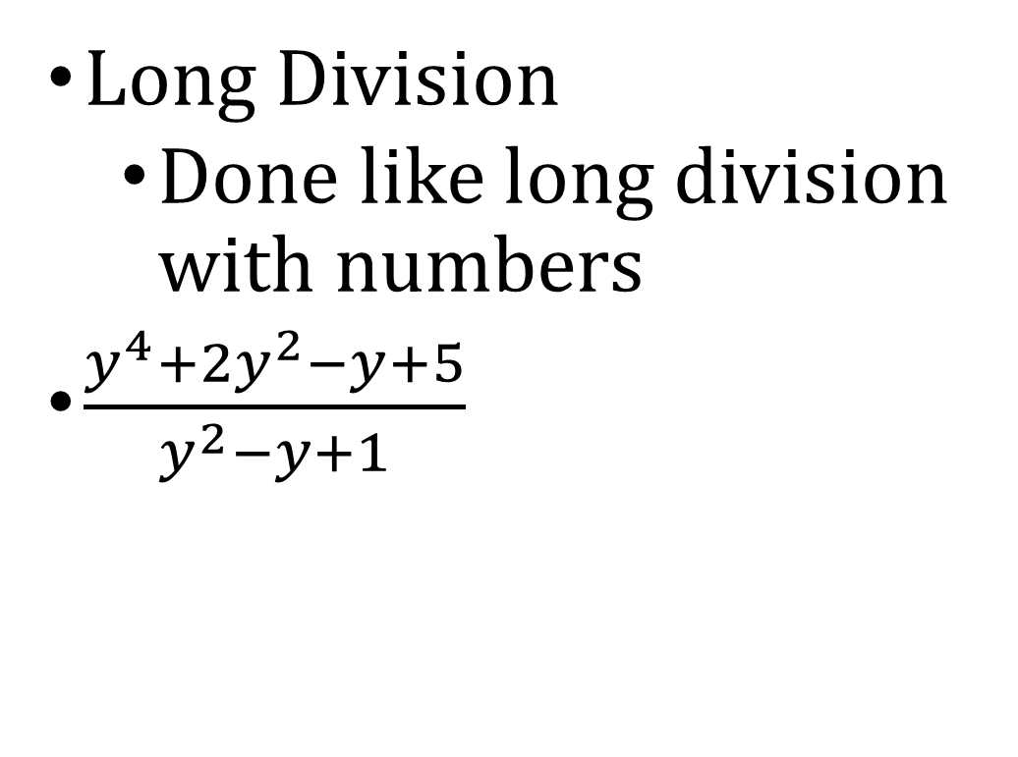


2-04 Dividing Polynomials
Long Division
  Done like long division with numbers
$\frac{y^{4}+2y^{2}−y+5}{y^{2}−y+1}$
$$y^{2}$$
$$+ y$$
$$+ 2$$
$+\frac{3}{y^{2}−y+1}$
$\left.y^{2}−y+1\right)\overline{y^{4}+0y^{3}+2y^{2}−y+5}$
$$y^{4}− y^{3}+ y^{2}$$
$$y^{3}+ y^{2}$$
Divide the 1st terms
$$−y$$
$$y^{3}− y^{2}+y$$
Multiply
$$2y^{2}−2y$$
$$+ 5$$
Subtract
$$2y^{2}−2y+2$$
$$3$$

Slide 27














2-04 Dividing Polynomials
$$x^{2}$$
$$+ 2x$$
$$− 7$$
$+\frac{24}{x+2}$
$\frac{x^{3}+4x^{2}−3x+10}{x+2}$
$\left.x+2\right)\overline{x^{3}+4x^{2}−3x+10}$
$$x^{3}+2x^{2}$$
Divide the 1st terms
$$2x^{2}$$
$$−3x$$
$$2x^{2}+4x$$
Multiply
$$−7x$$
$$+ 10$$
Subtract
$$−7x − 14$$
$$24$$

Slide 28

2-04 Dividing Polynomials
Synthetic Division
  Shortened form of long division for dividing by a binomial
  Only when dividing by $\left(x−r\right)$

Slide 29
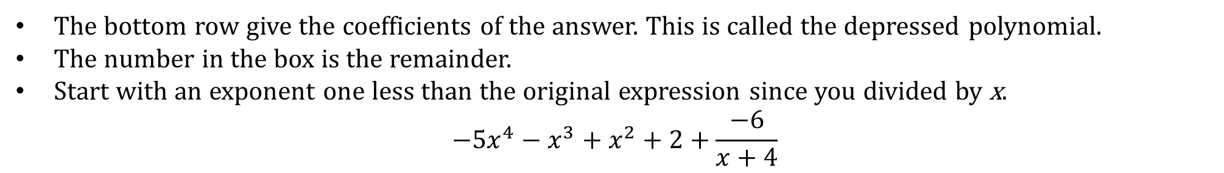

2-04 Dividing Polynomials
Synthetic Division
  $\left(−5x^{5}−21x^{4}−3x^{3}+4x^{2}+2x+2\right)/(x+4)$
Coefficients with placeholders
-4
-
5
-21
-3
4
2
2
+
+
+
+
+
+
×
20
4
-4
0
-8
-
5
-
1
1
0
2
-6
The bottom row give the coefficients of the answer. This is called the depressed polynomial.
The number in the box is the remainder.
Start with an exponent one less than the original expression since you divided by x.
$$−5x^{4}−x^{3}+x^{2}+2+\frac{−6}{x+4}$$

Slide 30

2-04 Dividing Polynomials
$\left(y^{5}+32\right){\left(y+2\right)}^{−1}$
Coefficients with placeholders
-2
1
0
0
0
0
32
+
+
+
+
+
+
×
-2
4
-8
16
-32
1
-
2
4
-8
16
0
The degree was 5, now the depressed polynomial is one less degree. It’s degree is 4.
$$y^{4}−2y^{3}+4y^{2}−8y+16$$

Slide 31

2-04 Dividing Polynomials
Factor Theorem
  If f(x) is divided by $(x−k)$ and remainder is 0, then $(x−k)$ is a factor of f(x)

Slide 32

2-04 Dividing Polynomials
Show that $\left(x+3\right)$ is a factor of $x^{3}−19x−30$. Then find the remaining factors.
Notes:
-3| 1 0 -19 -30
-3 9 30
1 -3 -10 |0
$$x^{2}−3x−10$$
$$\left(x−5\right)\left(x+2\right)$$
Ans: $\left(x+3\right)\left(x−5\right)\left(x+2\right)$

Slide 33
2-05 Rational Zeros of Polynomial Functions
In this section, you will:
Evaluate a polynomial using the Remainder Theorem.
Use the Factor Theorem to solve a polynomial equation.
Use the Rational Zero Theorem to find rational zeros.

Slide 34

2-05 Rational Zeros of Polynomial Functions
Remainder Theorem
  If f(x) is divided by $(x−k)$, then the remainder is $r=f(k)$

Slide 35

2-05 Rational Zeros of Polynomial Functions
Use the remainder theorem to evaluate
$f\left(x\right)=4x^{3}+10x^{2}−3x−8$ for $f(−1)$
Notes:
-1| 4 10 -3 -8
-4 -6 9
4 6 -9 |1
f(-1)=1

Slide 36

2-05 Rational Zeros of Polynomial Functions
Rational Zero Theorem
  If polynomial
  $f\left(x\right)=a_{n}x^{n}+a_{n−1}x^{n−1}+⋯+a_{2}x^{2}+a_{1}x+a_{0}$
  The rational zeros are in the form $\frac{p}{q}$
  where p = factors of $a_{0}$
  q = factors of $a_{n}$

Slide 37

2-05 Rational Zeros of Polynomial Functions
Find the rational zeros of $f\left(x\right)=x^{3}−5x^{2}+2x+8$ given that $x+1$ is a factor.
Notes:
$p=±1,±2,±4,±8$
$q=±1$
$\frac{p}{q}=±1,±2,±4,±8$
−1 | 1 −5 2 8
−1 6 −8
1 −6 8 | 0
Depressed Polynomial: $y=x^{2}−6x+8$
Since Quadratic, Solve $0=x^{2}−6x+8$
$$0=\left(x−2\right)\left(x−4\right)$$
$$x−2=0 or x−4=0$$
$$x=2 or x=4$$
Zeros: −1, 2, 4

Slide 38

2-05 Rational Zeros of Polynomial Functions
Find the real zeros of $f\left(x\right)=x^{3}−7x^{2}−11x+14$ given that $x+2$ is a factor.
Notes:
$p=±1,±2,±7,±14$
$q=±1$
$\frac{p}{q}=±1,±2,±7,±14$
−2 | 1 −7 −11 14
−2 18 −14
1 −9 7 | 0
Depressed Polynomial: $y=x^{2}−9x+7$
Since Quadratic, Solve $0=x^{2}−9x+7$
$$x=\frac{9±\sqrt{9^{2}−4\left(1\right)\left(7\right)}}{2\left(1\right)}$$
$$x=\frac{9±\sqrt{53}}{2}$$
Zeros: −2, $\frac{9±\sqrt{53}}{2}$

Slide 39
2-06 Zeros of Polynomial Functions
In this section, you will:
Find zeros of a polynomial function.
Use the Linear Factorization Theorem to find polynomials with given zeros.
Use Descartes’ Rule of Signs.

Slide 40
2-06 Zeros of Polynomial Functions
Fundamental Theorem of Algebra
  If f(x) is polynomial of degree n, then there is at least 1 zero
  There are exactly n zeros
  There are n linear factors (Linear Factorization Theorem)

Slide 41

2-06 Zeros of Polynomial Functions
Find all zeros of $f\left(x\right)=x^{4}−16$
Notes:
Factor
$$0=x^{4}−16$$
$$0=(x^{2}−4)(x^{2}+4)$$
$$0=\left(x−2\right)\left(x+2\right)\left(x^{2}+4\right)$$
$$x=2, −2, 2i, −2i$$

Slide 42

2-06 Zeros of Polynomial Functions
Find all the zeros of
$f\left(x\right)=2x^{4}−9x^{3}−18x^{2}+71x−30$
Notes:
$p=±1,±2,±3,±5,±6,±10,±15,±30$
$q=±1, ±2$
$\frac{p}{q}=±1,±\frac{1}{2}, ±2,±3,±\frac{3}{2},±5,±\frac{5}{2},±6,±10,±15,±\frac{15}{2},±30$
Pick one and divide
2 | 2 −9 −18 71 −30
4 −10 −56 30
2 −5 −28 15 | 0
Depressed polynomial: $2x^{3}−5x^{2}−28x+15$
Pick another possible zero and divide again
5 | 2 −5 −28 15
10 25 −15
2 5 −3 | 0
Depressed polynomial is quadratic
$$2x^{2}+5x−3=0$$
$$\left(2x−1\right)\left(x+3\right)=0$$
$$2x−1=0 or x+3=0$$
$$x=\frac{1}{2}, −3$$
Zeros: $−3,\frac{1}{2},2,5$

Slide 43
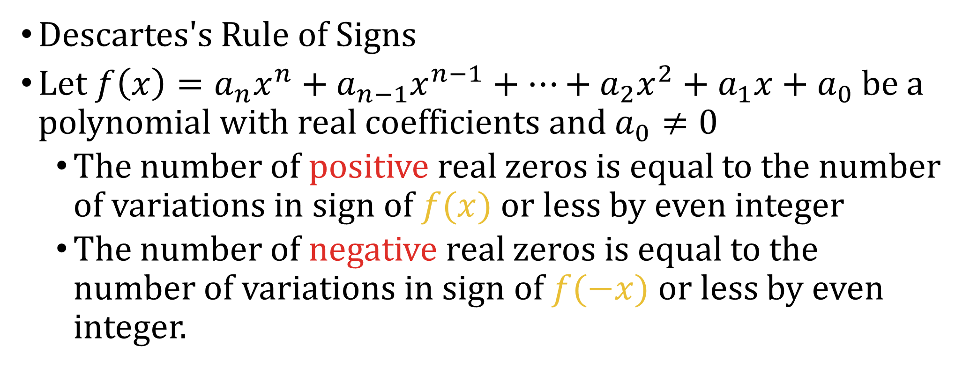
2-06 Zeros of Polynomial Functions
Descartes's Rule of Signs
Let $f\left(x\right)=a_{n}x^{n}+a_{n−1}x^{n−1}+⋯+a_{2}x^{2}+a_{1}x+a_{0}$ be a polynomial with real coefficients and $a_{0}≠0$
  The number of positive real zeros is equal to the number of variations in sign of $f(x)$ or less by even integer
  The number of negative real zeros is equal to the number of variations in sign of $f(−x)$or less by even integer.

Slide 44

2-06 Zeros of Polynomial Functions
Describe the possible real zeros of
$f\left(x\right)=−2x^{3}+5x^{2}−x+8$
Notes:
Positive: 3 or 1
Negative: $f\left(−x\right)=−2{\left(−x\right)}^{3}+5{\left(−x\right)}^{2}−\left(−x\right)+8$
$$f\left(−x\right)=2x^{3}+5x^{2}+x+8$$
0

Slide 45

2-06 Zeros of Polynomial Functions
Complex Conjugate Theorem
  If a complex number $a+bi$ is a zero, then $a−bi$ is also a zero.

Slide 46

2-06 Zeros of Polynomial Functions
Find a polynomial with real coefficients with zeros $\frac{2}{3}, −1, 3+\sqrt{2}i$
Notes:
$$\left(3x−2\right)\left(x+1\right)\left(x−\left(3+\sqrt{2}i\right)\right)\left(x−\left(3−\sqrt{2}i\right)\right)$$
$$3x^{4}−17x^{3}+25x^{2}+23x−22$$

Slide 47
2-07 Asymptotes of Rational Functions
In this section, you will:
Find the domains of rational functions.
Identify vertical asymptotes.
Identify horizontal asymptotes.

Slide 48

2-07 Asymptotes of Rational Functions
Rational Function
  Fraction
$f\left(x\right)=\frac{2x+1}{3x−4}$
Domain:
  Denominator ≠ 0
Notes:
3x-4≠0
X≠4/3
(-∞, 4/3) U (4/3, ∞)

Slide 49
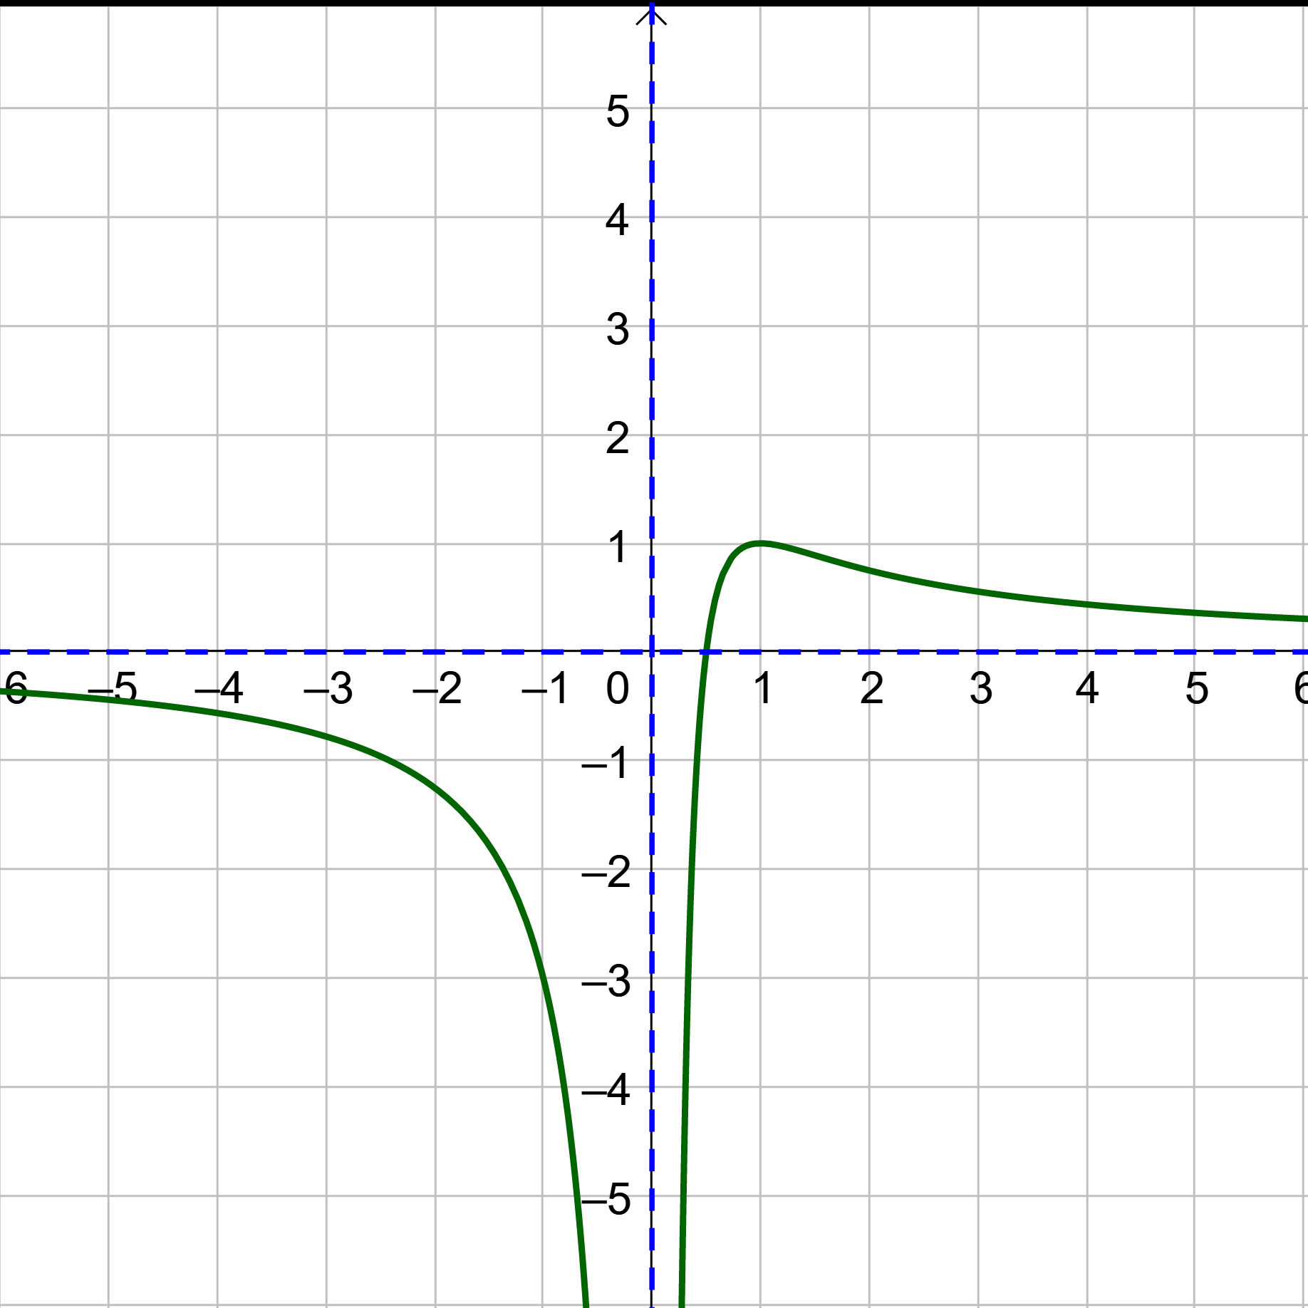
2-07 Asymptotes of Rational Functions
Asymptotes describe behavior of the graph at the edges

Slide 50
2-07 Asymptotes of Rational Functions
Vertical Asymptotes
  Factor and reduce
  Set denominator = 0 and solve for x
Horizontal Asymptotes
  Plug in huge number for x and simplify
  OR
  Find degree of numerator (N) and denominator(D)
  If N<D, y = 0
  If N=D, y = leading coeff
  If N>D, No HA

Slide 51

2-07 Asymptotes of Rational Functions
Find the asymptotes of $f\left(x\right)=\frac{5x^{2}}{x^{2}−1}$
Notes:
VA: $x^{2}−1=0 →x=−1, 1$
HA: $N=2, D=2 →$ leading coefficients y=5

Slide 52

2-07 Asymptotes of Rational Functions
For $f\left(x\right)=\frac{2x^{2}−x}{2x^{2}+x−1}$
  Find the domain
  Find the removable discontinuity
  Find the asymptotes
Notes:
Domain: $2x^{2}+x−1≠0 →\left(2x−1\right)\left(x+1\right)≠0 →x≠\frac{1}{2}, −1$
Discontinuity: Factor$\frac{x\left(2x−1\right)}{\left(2x−1\right)\left(x+1\right)}=\frac{x}{x+1}$→ (2x-1) cancels → $x=\frac{1}{2}$ → get point from reduced function $\left(\frac{1}{2},\frac{1}{3}\right)$
Asymptotes: VA: x=-1; HA: y=1

Slide 53

2-07 Asymptotes of Rational Functions
Slant Asymptote
  If $N=D+1$, Divide and ignore remainder
Find the asymptotes of $f\left(x\right)=\frac{3x^{2}+1}{x}$
Notes:
VA: x=0
HA: N=2, D=1 → N>D → no HA
SA: $\left(3x^{2}+0x+1\right)÷\left(x+0\right)=3x+\frac{1}{x}$ → y=3x

Slide 54
2-08 Graphs of Rational Functions
In this section, you will:
Find the intercepts of rational functions.
Graph rational functions.
Solve applied problems involving rational functions.

Slide 55

2-08 Graphs of Rational Functions
Intercepts
  x-int: let y = 0
    Numerator = 0
  y-int: let x = 0
Find the intercepts of $f\left(x\right)=\frac{3x^{2}−1}{x}$
Notes:
X-int: $±\frac{\sqrt{3}}{3}$
Y-int: none

Slide 56
2-08 Graphs of Rational Functions
To graph rational functions
  Find domain
  Find asymptotes
  Graph asymptotes as dotted lines
  Create table of values around vertical asymptotes
Plot points
Draw curves starting near an asymptote and ending near another asymptote
Don’t cross VA
Put any required holes. Check the domain

Slide 57

2-08 Graphs of Rational Functions
Graph $f\left(x\right)=\frac{3x^{2}+1}{x}$
Notes:
Domain: x ≠ 0
VA: x = 0
HA: none
SA: y = 3x

Slide 58

2-08 Graphs of Rational Functions
Graph $f\left(x\right)=\frac{3x}{x^{2}+x−2}$
Notes:
Factor: $\frac{3x}{\left(x+2\right)\left(x−1\right)}$
Domain: x ≠ −2, 1
VA: x = −2, x = 1
HA: y = 0

Slide 59
2-08 Graphs of Rational Functions
Find the function given a graph
Use the x-intercepts and multiplicity to get factors of numerator
  If cross x-axis: multiplicity 1 or 3
  If touch but not cross: multiplicity 2 or 4
Use VA to get factors of denominator
  If 1 end goes up and 1 down: multiplicity 1
  If both ends go same direction: multiplicity 2
Use any other point to get stretch factor, a

Slide 60
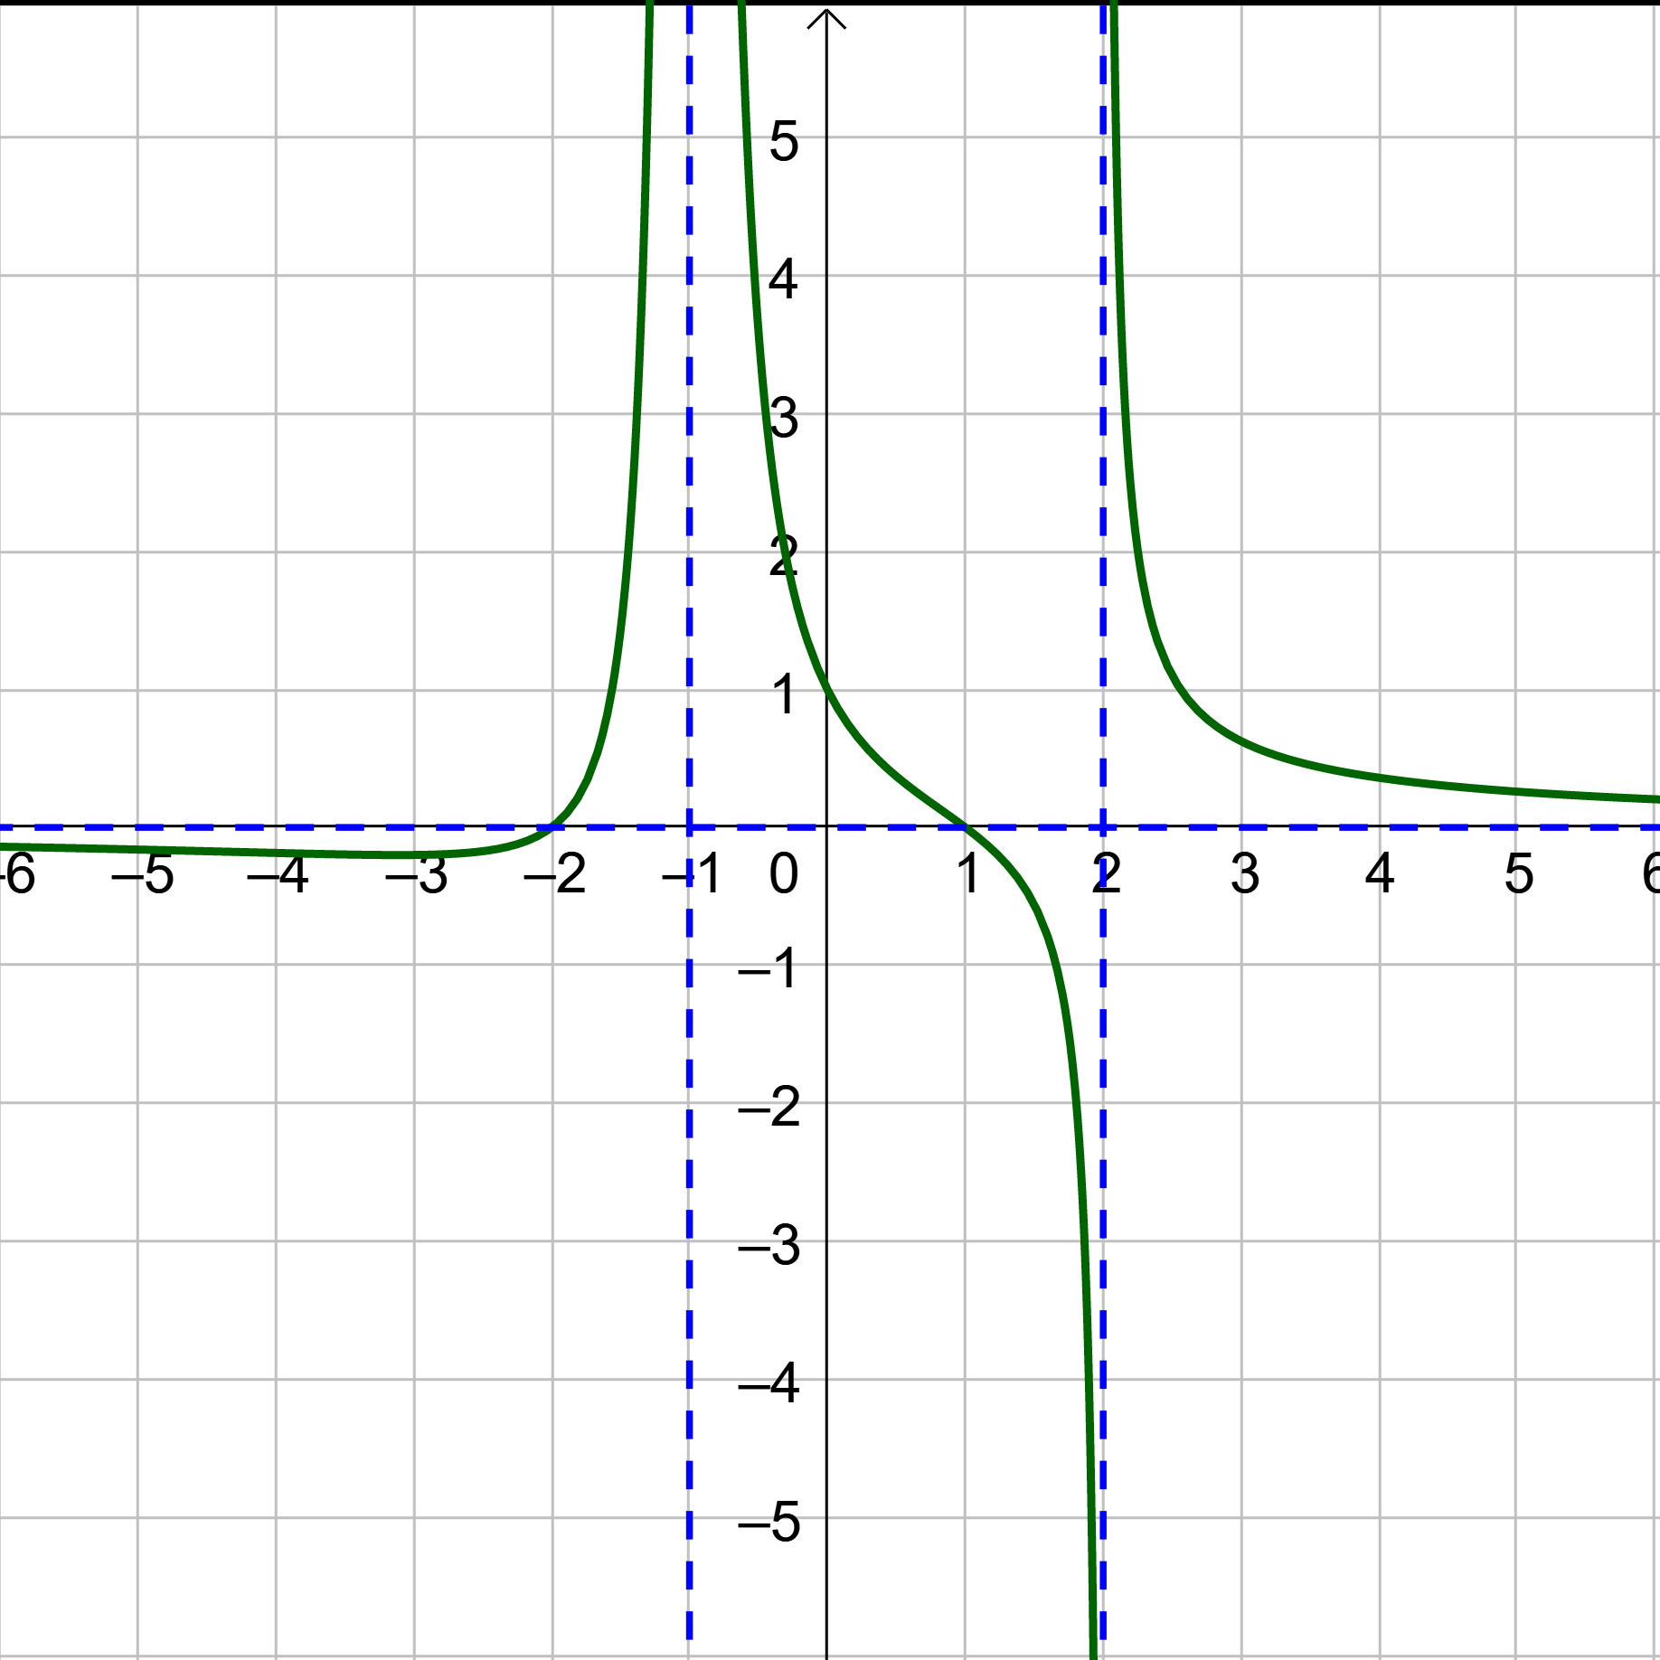
2-08 Graphs of Rational Functions
Find the function
Notes:
Numerator → X-ints: -2 and 1 with multiplicity 1 each. Factors of numerator are (x+2)(x-1)
Denominator → VA: x=-1 with multiplicity 2 and x=2 with multiplicity 1. Factors of denominator are (x+1)²(x-2)
Function is $f\left(x\right)=a\frac{\left(x+2\right)\left(x−1\right)}{{\left(x+1\right)}^{2}\left(x−2\right)}$
Use point (0,1) to find stretch factor a
$$1=a\frac{\left(0+2\right)\left(0−1\right)}{{\left(0+1\right)}^{2}\left(0−2\right)}$$
$$1=a\left(1\right)$$
$$a=1$$
Function is $f\left(x\right)=\frac{\left(x+2\right)\left(x−1\right)}{{\left(x+1\right)}^{2}\left(x−2\right)}$

Slide 61
2-09 Nonlinear Inequalities
In this section, you will:
Find critical numbers of nonlinear inequalities.
Solve one-variable nonlinear inequalities algebraically.
Solve one-variable nonlinear inequalities by graphing.

Slide 62

2-09 Nonlinear Inequalities
Steps to solve
Make one side 0
Find critical #’s
  Zeros
  Undefined
Plot on #-line
Pick test points and test them
Solve $x^{2}−5x−6<0$
Notes:
Zeros: 6, -1 (no undefined)
Test points: -2 (F), 0 (T), 7 (F)
Answer: -1<x<6 or (-1, 6)
Also solve by showing graph overlaid on number line

Slide 63

2-09 Nonlinear Inequalities
Solve $3x^{3}−4x^{2}−12x>−16$
Notes:
Make 0 on right side
Factor by grouping
Critical numbers:
zeros: 4/3, 2, -2
no undefined
Test points -3 (F), 0(T), 3/2(F), 3 (T)
Answer: $\left(−2,\frac{4}{3}\right) U \left(2, ∞\right)$
Also solve by showing graph overlaid on number line

Slide 64

2-09 Nonlinear Inequalities
Solve $\frac{3x−5}{x−3}≤1$
Notes:
Make right side 0 (use common denominator (x-3) to combine fractions
$$\frac{3x−5}{x−3}−\frac{x−3}{x−3}≤0$$
$$\frac{2x−2}{x−3}≤0$$
Critical numbers
zeros: 1 (can be equal to)
undefined: 3 (cannot be equal to)
Test points: 0 (F), 2(T), 4(F)
Answer: [1, 3)
Also solve by showing graph overlaid on number line

